Slide 1
Suffix arrays:
A new method for on-line string searches
Udi Manber and Gene Myers
SIAM Journal on Computing, vol. 22(5), pp. 935–948, 1993
Presenter: Yung-Hsing Peng
Date: May 04, 2006

Slide 2
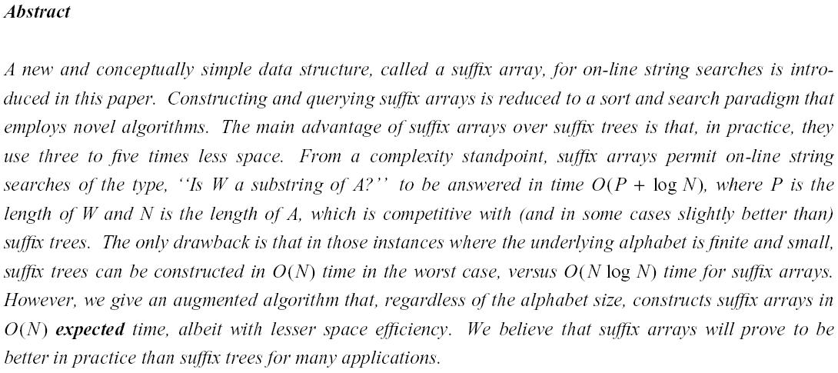

Slide 3
Suffixes
Suffixes for S=“ATCACATCATCA”
ATCACATCATCA | S₁
TCACATCATCA | S₂
CACATCATCA | S₃
ACATCATCA | S₄
CATCATCA | S₅
ATCATCA | S₆
TCATCA | S₇
CATCA | S₈
ATCA | S₉
TCA | S₁₀
CA | S₁₁
A | S₁₂

Slide 4
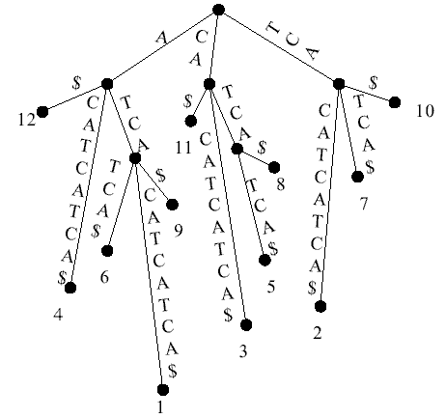
Suffix Trees
A suffix Tree for S=“ATCACATCATCA”

Slide 5
Suffix Arrays
Suffix Array for S=“ATCACATCATCA”
ATCACATCATCA | S₁
TCACATCATCA | S₂
CACATCATCA | S₃
ACATCATCA | S₄
CATCATCA | S₅
ATCATCA | S₆
TCATCA | S₇
CATCA | S₈
ATCA | S₉
TCA | S₁₀
CA | S₁₁
A | S₁₂
A | S₁₂
ACATCATCA | S₄
ATCA | S₉
ATCACATCATCA | S₁
ATCATCA | S₆
CA | S₁₁
CACATCATCA | S₃
CATCA | S₈
CATCATCA | S₅
TCA | S₁₀
TCACATCATCA | S₂
TCATCA | S₇
Sort
Suffix Array
12 | 4 | 9 | 1 | 6 | 11 | 3 | 8 | 5 | 10 | 2 | 7

Slide 6
Two Main Topics
How to search a string P in a suffix array?
(1) O(|P|logn+k) time naïve binary search
(2) O(|P|+logn+k) time binary search with the lcp information
How to construct a suffix array?
→The authors proposed an O(nlogn) time algorithm, which also computes the needed lcp information during construction.
n: the length of T
k: the number of reported positions

Slide 7
Binary Search with lcp information (1/2)
lcp(X,Y): the length of the longest common prefix between two strings X and Y
Left Interval (0~5)
Right Interval (5~11)
Array
12 | 4 | 9 | 1 | 6 | 11 | 3 | 8 | 5 | 10 | 2 | 7
L=0
M=(0+11)/2=5
R=11
For searching P, one can first compute l = lcp(S_{Array[0]}, P)
Afterwards, there are three cases to discuss
(1) l < lcp(S_{Array[L]}, S_{Array[M]}) → Recursively search right interval.
(2) l = lcp(S_{Array[L]}, S_{Array[M]}) → Compute lcp(S_{Array[M]},P), then decide which interval to search in. (Note that we can skip the first l comparisons)
(3) l > lcp(S_{Array[L]}, S_{Array[M]}) → Recursively search left interval.

Slide 8
Binary Search with lcp information (2/2)
Only O(n) pairs of lcp(S_{Array[L]}, S_{Array[M]}) are needed. (one for each interval)
These values can be obtained when constructing the suffix array.
Searching time: O(|P|+logn+k), since each comparison either halves the searching range, or consumes one letter in P.
Since we already know how to search in a suffix array, the remaining problem is how to construct this suffix array, along with the demanded lcp information.

Slide 9
Introduction to H-Buckets
An H-Bucket store the set of suffixes, where the lcp value of these suffixes is at least H.
The sorting is accomplished by constructing 1-buckets, 2-buckets, 4-buckets,…,2^{logn}-buckets. (This takes O(logn) stages)

Slide 10
Main Idea for Sorting
1-buckets
ATCACATCATCA | S₁
TCACATCATCA | S₂
CACATCATCA | S₃
ACATCATCA | S₄
CATCATCA | S₅
ATCATCA | S₆
TCATCA | S₇
CATCA | S₈
ATCA | S₉
TCA | S₁₀
CA | S₁₁
A | S₁₂
A
C
T
1, 4, 6, 9, 12
3, 5, 8, 11
2, 7, 10
To construct 2-buckets, seems that one needs to compare the second letters.
However, this comparison can be done by reusing the information in 1-buckets.
EX: For two suffixes S1 and S4 in the 1-bucket A, we have
S₁=ATCACATCATCA, S₂=TCACATCATCA
S₄=ACATCATCA, S₅=CATCATCA
→The order of S₁ and S₄ in 2-buckets is decided by the order of S₂ and S₅ in 1-buckets.

Slide 11
Sorting All Suffixes by Using H-buckets
When h-buckets are constructed, it means that the suffixes are already sorted according their first h letters.
2h-buckets can be constructed by using information in h-buckets
To use this information, one can perform a linear time update in h-buckets, producing 2h-buckets in O(n) time. The suffix S_{i} can be used to update the order of the suffix S_{i-h}
Please see the example in the following pages.

Slide 12
1-buckets
2-buckets
A
C
T
A
C
T
1, 4, 6, 9, 12
3, 5, 8, 11
2, 7, 10
A
C
T
A
CA
T
1, 4, 6, 9, 12
3, 5, 8, 11
2, 7, 10
3
A
C
T
A
CA
T
1, 4, 6, 9, 12
3, 5, 8, 11
2, 7, 10
3, 5
A
C
T
A
CA
T
1, 4, 6, 9, 12
3, 5, 8, 11
2, 7, 10
3, 5, 8

Slide 13
1-buckets
2-buckets
A
C
T
A
CA
T
1, 4, 6, 9, 12
3, 5, 8, 11
2, 7, 10
3, 5, 8, 11
A
C
T
A
CA
TC
1, 4, 6, 9, 12
3, 5, 8, 11
2, 7, 10
3, 5, 8, 11
2
A
C
T
AC
CA
T
1, 4, 6, 9, 12
3, 5, 8, 11
2, 7, 10
4
3, 5, 8, 11
2
A
C
T
AC
CA
T
1, 4, 6, 9, 12
3, 5, 8, 11
2, 7, 10
4
3, 5, 8, 11
2, 7

Slide 14
1-buckets
2-buckets
A
C
T
AC
CA
TC
1, 4, 6, 9, 12
3, 5, 8, 11
2, 7, 10
4
3, 5, 8, 11
2, 7, 10
A
C
T
AC
AT
CA
TC
1, 4, 6, 9, 12
3, 5, 8, 11
2, 7, 10
4
1
3, 5, 8, 11
2, 7, 10
A
C
T
AC
AT
CA
TC
1, 4, 6, 9, 12
3, 5, 8, 11
2, 7, 10
4
1, 6
3, 5, 8, 11
2, 7, 10
A
C
T
AC
AT
CA
TC
1, 4, 6, 9, 12
3, 5, 8, 11
2, 7, 10
4
1, 6, 9
3, 5, 8, 11
2, 7, 10

Slide 15
1-buckets
2-buckets
A
C
T
AC
AT
CA
TC
1, 4, 6, 9, 12
3, 5, 8, 11
2, 7, 10
4
1, 6, 9
3, 5, 8, 11
2, 7, 10
A
AC
AT
CA
TC
12
4
1, 6, 9
3, 5, 8, 11
2, 7, 10
Next: Construct 4-buckets using 2-buckets
Note that in real implementation, one doesn’t have to record the labels A, AC, AT, CA and TC. In addition, the bucket in which S_{i-h} resides can be located in constant time by building a table in advance.
Total O(logn) stages and each takes O(n) time to complete → Time complexity O(nlogn)

Slide 16
lcp Values of Adjacent Suffixes
A | S₁₂
ACATCATCA | S₄
ATCA | S₉
ATCACATCATCA | S₁
ATCATCA | S₆
CA | S₁₁
CACATCATCA | S₃
CATCA | S₈
CATCATCA | S₅
TCA | S₁₀
TCACATCATCA | S₂
TCATCA | S₇
Suffix Array
12 | 4 | 9 | 1 | 6 | 11 | 3 | 8 | 5 | 10 | 2 | 7
Adjacent lcp (ALCP)
- | 1 | 1 | 4 | 4 | 0 | 2 | 2 | 5 | 0 | 3 | 3
Adjacent lcp can be computed during the sorting.

Slide 17
Computing lcp Values of Adjacent Suffixes (1/4)
A
C
T
1-buckets
1, 4, 6, 9, 12
3, 5, 8, 11
2, 7, 10
- | ? | ? | ? | ? | 0 | ? | ? | ? | 0 | ? | ?
A
AC
AT
CA
TC
12
4
1, 6, 9
3, 5, 8, 11
2, 7, 10
2-buckets
- | 1 | 1 | ? | ? | 0 | ? | ? | ? | 0 | ? | ?
Observation: Adjacent lcp values can be computed when splitting.

Slide 18
Computing lcp Values of Adjacent Suffixes (2/4)
Suppose S_{i} and S_{j} are two suffixes, i < j, which reside in the same h-bucket, but different 2h-buckets. → lcp(S_{i},S_{j}) = h + lcp(S_{i+h},S_{j+h}), and 0 ≤ lcp(S_{i+h},S_{j+h}) ≤ h-1
Suppose S_{i+h} and S_{j+h} are the pth and qth suffix in the suffix array, we have lcp(S_{i+h},S_{j+h}) = min{ ALCP[k] }, p+1 ≤ k ≤ q.
Suffix Array
12 | 4 | 9 | 1 | 6 | 11 | 3 | 8 | 5 | 10 | 2 | 7
Adjacent lcp ALCP
- | 1 | 1 | 4 | 4 | 0 | 2 | 2 | 5 | 0 | 3 | 3
For example, lcp(S₁, S₅) = 0, since min{1, 4, 4, 0, 2, 2, 5} = 0
Challenge: Given an interval, how can one efficiently find the smallest element in this interval?

Slide 19
Computing lcp Values of Adjacent Suffixes (3/4)
Interval tree of ALCP (record the smaller child)
0
0
1
0
0
1
1
0
2
0
3
- | 1 | 1 | 4 | 4 | 0 | 2 | 2 | 5 | 0 | 3 | 3
The red paths illustrate the interval. Only the red elements will be discussed.
The elements outside the interval will be ignored.
→ This tree can be constructed in O(n) time, while it can be used to find the smallest element in any given interval in O(logn) time.

Slide 20
Computing lcp Values of Adjacent Suffixes (4/4)
In real implementation, the unknown value can be replaced by ∞
There are at most n queries for the smallest element, since each query successfully obtain one value of adjacent lcp.
After each query, the new adjacent value will be stored in a leaf node, which can be used to update the interval tree in O(logn) time.
→ It takes O(nlogn) time to compute lcp values for all adjacent suffixes in a suffix array.

Slide 21
Computing Demanded lcp Values for Searching
With the interval tree, lcp(S_{i}, S_{j}) can be found in O(logn) time, for any 1 ≤ i < j ≤ n.
There are only n lcp values demanded for searching. (see previous pages about searching)
→The demanded lcp values can be computed in O(nlogn) time.
The suffix array can be constructed in O(nlogn) time, while it takes O(|P|+logn+k) time to search a string P in this array.

Slide 22
Expected Time Complexity
It was shown that the longest repeated substring in a random text 2log_{|Σ|}n + O(1)[KGO83]. → Expected time for sorting is O(nloglogn).
The authors further showed that the expected time complexity of their sorting algorithm is O(n). (Please read this paper)

Slide 23
Recently…
An O(|P|+k) time searching algorithm was proposed for finite alphabet.[AOK02]
Two linear time algorithms were proposed for constructing suffix array over integer alphabet. [KA05, KSPP05]
(3)Experiments showed that suffix arrays outperform suffix trees, both in constructing time and searching time.

Slide 24
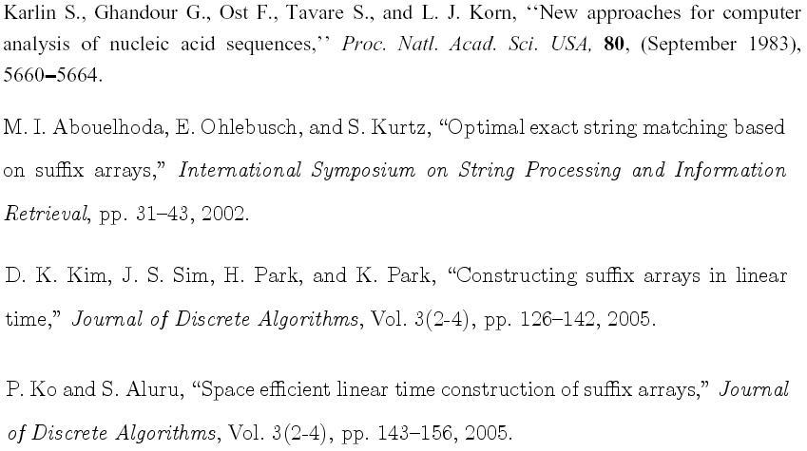
Related Reference
[KGO83]
[AOK02]
[KSPP05]
[KA05]

